Slide 1
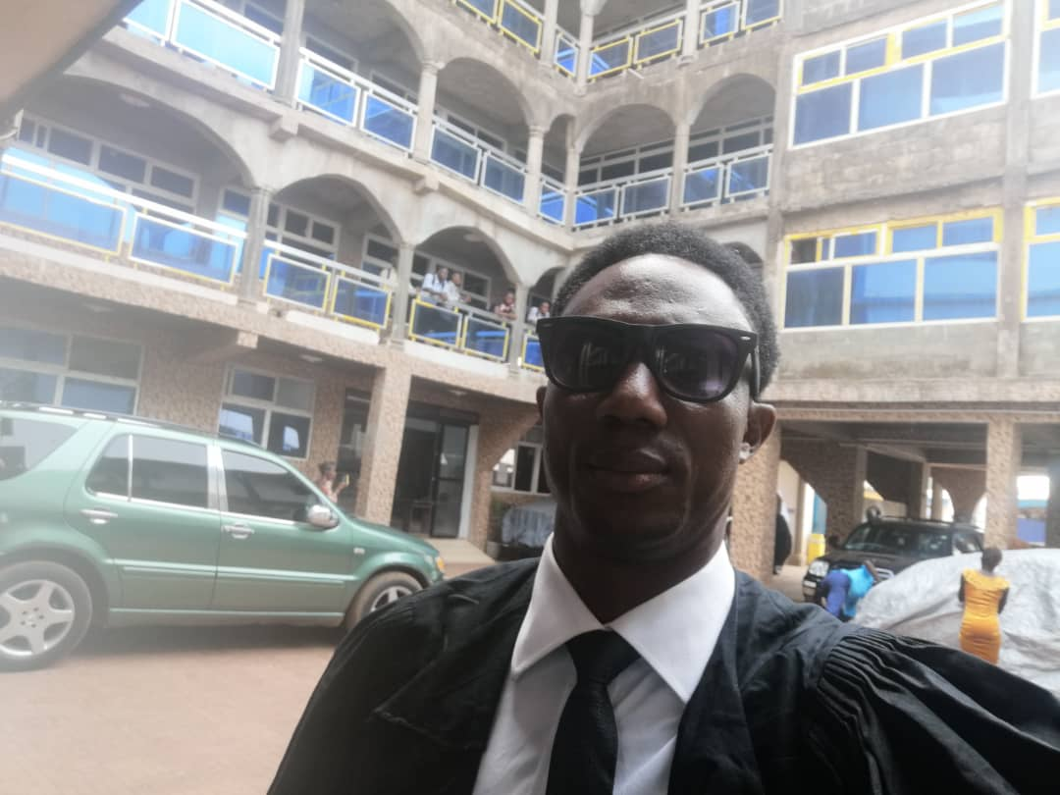
Introduction: MOHAMED BRITISH BANGURA
Photo
Motivation | To get knowledge and skills in machine learning, knowing python and AI.
Dream/Career | Ability to execute task/project in machine learning using python and it environment.
Programming Experience | Basic HTML
Application Idea | Basic wed development.
Expectation for DIVE INTO CODE | Able to work or undertake any project relating to machine learning upon completion of the training, spending more time in reading related materials, do researches read pdf and all relevant materials provided and practicing the coding processes.
Worries/Concern | No coding knowledge and difficulty in connecting to DIVER when you are offline to access pre learning materials.
Commitment | Try spending more time in reading and practicing daily.

